Slide 1
6.28.2024
Stewarding the Collective Collection:
US and Canadian perspectives on workflows, data, and tools for Shared Print
Lynn Silipigni Connaway, Ph.D.
Executive Director, Research
OCLC Research
connawal@oclc.org
Notes:
Hello, and thanks for the opportunity to speak with you today. I’m Lynn Silipigni Connaway, Executive Director of Research at OCLC, and I'm going to talk about one of our current projects that’s exploring data, tools, and workflows supporting shared print programs. I'll give some background on the project, including how we approached the work, talk about a few preliminary findings, and then give a brief overview of next steps, including some ways you can engage with this work.

Slide 2
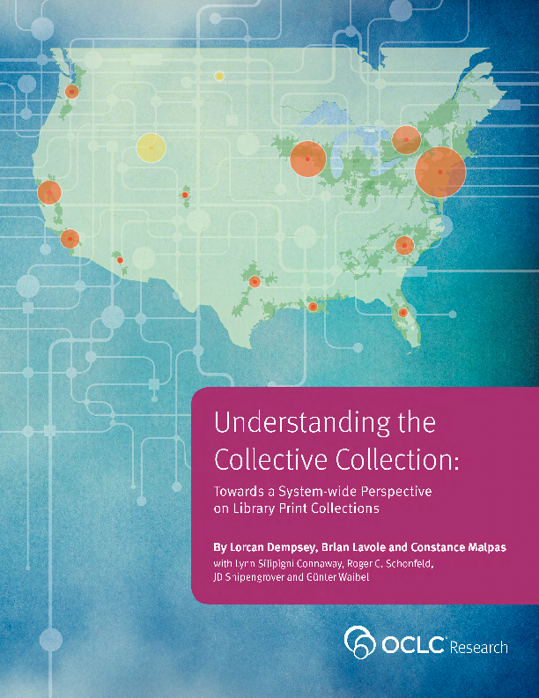
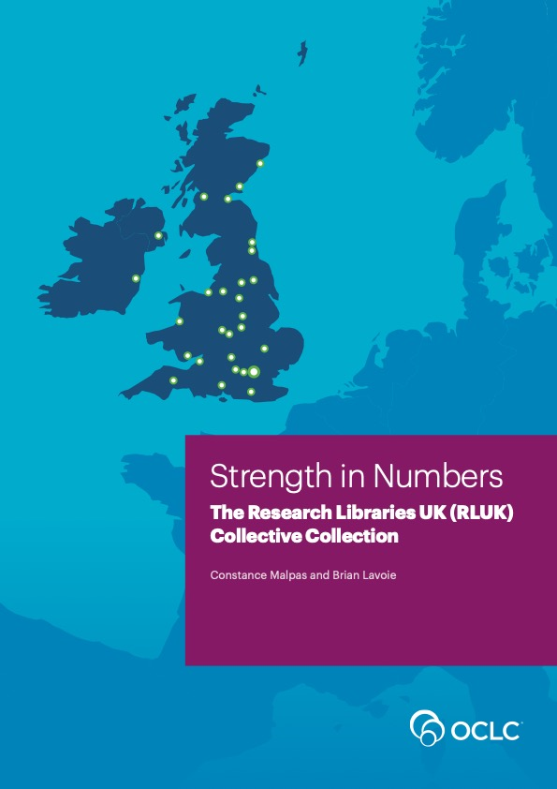
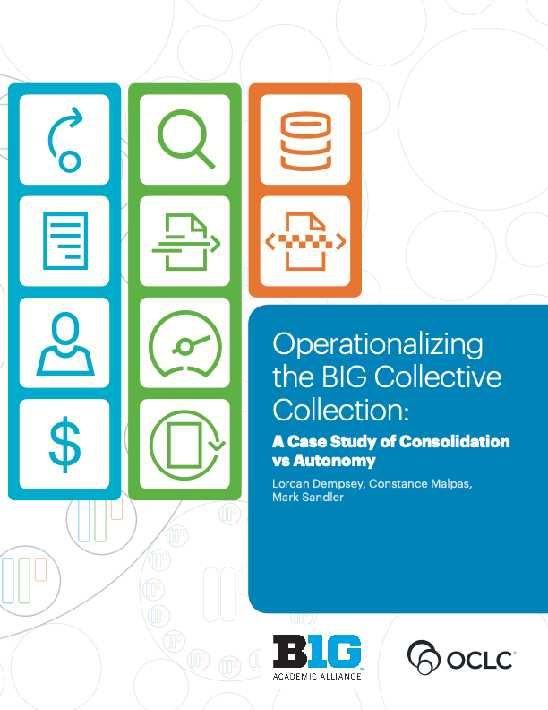
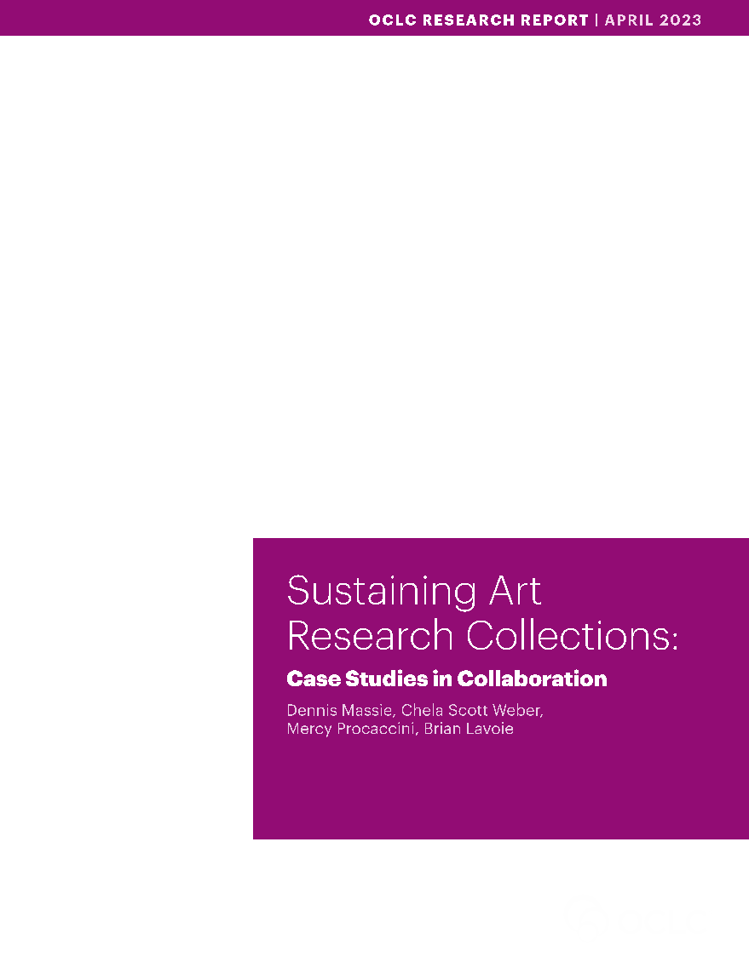
Notes:
The background for this project begins with OCLC Research’s long history of conducting studies focused on collective collection analysis [– and I should mention that by “collective collection”, we mean the combined collections of a group of institutions, analyzed or even managed as a single collection]. On the slide you see a selection of some of the collective collection reports we’ve released over the years.
I’d like to point out that a lot of these studies address collective collections in the context of shared print. So for example, one study looks at the print monographic holdings of the CIC membership (what’s now BTAA). Another did a similar analysis for Research Libraries UK. And a few years ago we explored large, regional print monographic collective collections as a way of re-imagining the geographical boundaries of shared print partnerships. So shared print has been a big focus in our collective collections work.

Slide 3
Stewarding the collective collection:
US and Canadian perspectives on workflows, data, and tools for Shared Print
Print monographs
Shared print workflows
What data and tools are used?
+
Notes:
And that brings us to the project we’d like to talk about today, which we call Stewarding Collective Collections: US and Canadian Perspectives on Workflows, Data, and Tools for Shared Print. Our focus here is on the data and tools used to manage collective collection workflows in a shared print context for monographic materials.
The origin of this work came out of ideas from conversations with colleagues at BTAA, which we later refined and are now carrying forward as an OCLC research project. I’m happy to share that we are working in partnership with SCELC, which is the Statewide California Electronic Library Consortium, and they are helping with project activities like recruiting interview participants and disseminating project findings.

Slide 4
Collective collections
Conceptualize
Analyze
Operationalize
Notes:
It's useful to mention that a lot of our work on collective collections in general, and shared print in particular, has focused on conceptualizing and analyzing collective collections that we constructed in data: for example, determining their size, what their key features are, and so forth. But more recently, we’ve shifted emphasis to operationalizing collective collections: in other words, work that explores how to make collective collections a reality, and how to make them work.
So a couple of examples: a few years ago we collaborated with BTAA to publish a study that offered a framework and recommendations on how BTAA could move toward greater coordination of their collective print holdings. And some of our most recent work looks at how art libraries could use collaborative approaches to better support the stewardship and sustainability of their collective art research holdings. Our current project on shared print workflows, data, and tools is very much situated in this "operationalize" category.

Slide 5
Collective collections
Conceptualize
Analyze
Operationalize
Notes:
It's useful to mention that a lot of our work on collective collections in general, and shared print in particular, has focused on conceptualizing and analyzing collective collections that we constructed in data: for example, determining their size, what their key features are, and so forth. But more recently, we’ve shifted emphasis to operationalizing collective collections: in other words, work that explores how to make collective collections a reality, and how to make them work.
So a couple of examples: a few years ago we collaborated with BTAA to publish a study that offered a framework and recommendations on how BTAA could move toward greater coordination of their collective print holdings. And some of our most recent work looks at how art libraries could use collaborative approaches to better support the stewardship and sustainability of their collective art research holdings. Our current project on shared print workflows, data, and tools is very much situated in this "operationalize" category.

Slide 6
Research questions
What are the key workflows supporting stewardship of shared print collections?
What data and tools are currently used to support these workflows?
What gaps in data, tools, or other resources exist?
Notes:
Just briefly, these are the research questions we’re addressing in our project.
First, what are the key workflows supporting stewardship of shared print monograph collections? These workflows include activities such as:
Selecting materials for inclusion in the program
Documenting retention commitments
Maintaining robust resource sharing networks
And even addressing issues like reparative description and redressing inequities in collection development and access.
Then second, what data and tools are currently used to support these workflows? We want to identify existing tools and infrastructure – like collections data, collection analysis tools, collection management systems – that support workflows and decision-making in a shared print context.
And then third, what gaps in data, tools, or other resources exist? And how might addressing these gaps open up new opportunities for collective stewardship of print collections?

Slide 7
Project activities
Data collection
Interviews
Focus group
Individual
Surveys
Analysis and synthesis
Disseminate findings
Webinars, publications
Notes:
The interviews were designed to provide a more holistic view of current practices of shared print monographic programs' workflows and tools as well as the workflow gaps and challenges.
The online survey is focused on identifying the gaps and challenges associated with the current data and tools used for stewarding shared print monographic collections.

Slide 8
Goals
Provide libraries with benchmark for current state of practice of workflows, data, and tools supporting monographic shared print collections
Help optimize local and group practices regarding collection evaluation and coordinated collection stewardship
Synthesize community views on data and functionality needs, and help identify priorities
Notes:
Here's a look at what we hope to accomplish with the project. First, we'd like to provide libraries with a benchmark view of the current state of practice surrounding shared print workflows, data, and tools.
Second, by providing this benchmark view, we'd like to help libraries continue to optimize practices having to do with collection evaluation and coordinated collection stewardship in general, both at the local and group level.
And third, we think this work can help synthesize community views on data and functionality needs in the area of monographic shared print, and help identify priorities to address.

Slide 9
Summary of data collection to date
Data collection: November 9, 2023 - April 12, 2024
Seven focus group interviews
28 individual participants
Five deans/directors, two AULs for collections, eight collections librarians/strategists, six metadata librarians, six resource sharing librarians, and one research/instruction librarian
Nine individual interviews
Representing seven Shared Print programs

Slide 10
Preliminary findings: Incentives
General benefits:
Institution-specific:
Collective responsibility
Last copies
Access
Cost savings
Mgmt. of physical space
Decision support
Shared capacities
Notes:
Our data collection work is nearing completion and we've already started analyzing the data we've gathered. To give you a flavor of some things we've found, I'll share a few preliminary findings on motivations and workflows, based on the interviews we've conducted with shared print program participants and managers.
One question we asked during the interviews was "what were the primary motivations for participating in monographic shared print programs". We received a wide range of responses, but they generally rolled up into two categories: General Benefits, which are outcomes that benefit the library community at large, and Institution-specific Benefits, which are outcomes that benefit individual institutions participating in shared print.
General Benefits included a sense of fulfilling a collective responsibility for stewarding the print record, with a special focus on identifying rare or last copies of print monographs to ensure they are preserved for ongoing use.
Institution-specific benefits we heard about include things like:
Extending access to print materials beyond local holdings
Lowering the per-institution cost of managing print monographs
Reducing the footprint of the print collection in the library's physical space
Using the shared print collection as a context against which to place local collection decision-making (e.g., weeding, moving materials to storage, acquisition choices)
Having access to shared capacities (e.g., facilities, systems, data, etc.), which may be more efficient than building these capacities locally. And for some institutions, shared capacities could be the only feasible option.

Slide 11
Collective responsibility
Notes:
I'd like to focus for a minute on the "collective responsibility" motivation for participating in monographic shared print programs, because I think it's important to highlight that many libraries see their contribution to shared print as a way of promoting the common good.

Slide 12
Collective responsibility
“I think because as a research institution, we really see it as our responsibility and mission to maintain the scholarly record …”
(Acquisitions & Discovery Librarian – FG03MD04)
Notes:
To illustrate this, here's a quote from an Acquisitions & Discovery Librarian we interviewed. They said: "I think because as a research institution, we really see it as our responsibility and mission to maintain the scholarly record." This view was shared by others we spoke to: that shared print was not just a strategy to help local print management needs, but a way to fulfill a collective responsibility to the print record.

Slide 13
Preliminary findings: Workflows
Metadata management
Collection analysis
Managing off-site storage
Verification
Discovery, access, and delivery (D2D)
Program governance
Notes:
We also gathered perspectives on what our interviewees saw as the major workflows involved in supporting monographic shared print programs. These were described in different ways by different interviewees, but generalizing over specific details, the responses could be summarized by these major workflow cataegories:
Metadata management, which includes activities like creating and updating cataloging data; setting retention commitments; and submitting or ingesting metadata in shared systems.
Collection analysis, which means analyzing holdings in support of collection management decisions like weeding, storage, determining contributions to shared print programs, identifying last copies, and so on.
Managing off-site storage, which includes current uses of off-site storage facilities, staff allocation, managing environmental controls, and planning.
Verification, which includes activities like verifying the accuracy of submitted metadata records, or manual verification that materials a library thinks it holds, or in other words, that the catalog says it holds, are in fact on the shelves.
Support for the discovery, accessibility, and delivery of monographs in shared print programs.
Program governance, which is the time and resources spent participating in the operations of the shared print program itself, like governance structures, committees, policy-making, and so on.
This is not necessarily a comprehensive list of shared print workflows, but it represents the areas our respondents highlighted as the key components of their participation in shared print programs.

Slide 14
An ingest example
Notes:
Just to give you a sense of how our respondents described these workflows in context, let's look at an example from one of the people we spoke to who was talking about the process by which staff operating a shared print program ingested contributed materials into the collection.

Slide 15
An ingest example
“So when we receive items there’s a whole verification process that the items actually go through before they’re shelved … There’s a lot of that kind of backend intellectual work that goes on, to make sure those records are clean and any kind of enhancements that are needed at that point, they [partner libraries] receive those …”
(Shared Print Manager - CSPM08)
Notes:
This quote is from a shared print manager we spoke to, and as you can see, the process of ingesting books into the shared print collection involves several of the workflows we talked about a few minutes ago, including verification and metadata management. I think it's particularly interesting how this interviewee emphasizes what they call the "backend intellectual work" that must be performed to ensure that metadata gathered from different libraries, that are perhaps using different cataloging systems and practices, is updated and enhanced sufficiently to support management of the shared print program.

Slide 16
Preliminary findings: Workflow challenges
Benchmarking
Staff
Facilities
Digitization
Coordination and harmonization across programs
Data quality
Community of practice
Technical interoperability
Integration with local workflows
Notes:
In talking about the major shared print workflows they engaged in, our interviewees also discussed important challenges they encountered in carrying them out. Again, like the workflows themselves, these challenges were described in different ways by different interviewees, but in general, they could be summarized by this list, which includes in no particular order:
Gathering evidence or metrics on the current status of the shared print program (e.g., how much of the collective collection is under retention commitments?), as well as evidence pertaining to outcomes or benefits (e.g., is access & usage increasing?)
Assembling, training, and deploying sufficient staffing to support shared print workflows
Obtaining and/or managing physical facilities needed to support shared print workflows
Carrying out digitization efforts, such as the availability of digitization equipment/tools, expertise, and staffing
Issues or conflicts that arise when an institution participates in multiple shared print programs, such as conflicts in retention policies, or different practices, conventions, and workflows
Issues involving the quality of the data used in support of shared print workflows, such as inaccuracies or lack of completeness
Lack of a "community of practice" across participating institutions, such as a common workflow organization, shared standards or conventions, and equitable distribution of retention commitments across members
Lack of compatability across systems and tools used in shared print workflows, including compatability across tools used locally, as well as compatability across tools used at different institutions in the shared print program
Issues with integrating shared print workflows with workflows supporting local collection management

Slide 17
Name a big challenge
Notes:
As we saw on the last slide, data quality was one of the challenges that interviewees we spoke to identified as impacting their ability to effectively carry out shared print workflows. Let's look at an example of how that challenge actually manifests itself in practice.

Slide 18
Name a big challenge
“… the labor involved in actually checking to see whether the item actually exists …”
(Collections Librarian - FG02CL01)
Notes:
Several of the people we spoke to, when asked about big challenges in shared print workflows, described the effort involved in checking that a book that the catalog says a library holds actually exists, like this Collections Librarian we spoke to. Often, this effort involves sending someone into the stacks to manually verify that a book the library is supposed to hold and is considering placing a retention commitment on, exists and is actually on the shelf. For institutions that typically have very limited staff resources to allocate to shared print, this can be a significant burden.

Slide 19
General theme: Need for resources
Shared print is under-resourced ...
Staff
Budget (“Willingness to pay”)
Institutional attention
… which limits scalability and benefits
Notes:
The quote on the last slide is a nice segue into one last comment I'd like to make about these preliminary findings on workflows and workflow challenges. A general theme that cuts across many of the challenges we heard about is the need for additional resources to support shared print. These resources include:
Additional staffing allocated to shared print participation and management
Additional funding to support participation in and management of shared print programs
Now the need for staff and funds is probably very familiar to all of you, but another resource deficit that our interviewees spoke about is institutional attention. There needs to be greater awareness – both within the library and beyond – about the importance of shared print, what it is trying to accomplish, and the commitment and resources needed to accomplish those goals.
A big message we heard from our interviewees is that not addressing these resource gaps in staff, budget, and attention really limits the scalability and benefits of shared print programs.

Slide 20
Resources are key
Notes:
So resources are key for shared print, as they are for any other aspect of fulfilling the library mission.

Slide 21
Resources are key
“I’m not sure...what it means to be sustainable. Because you can’t do everything for free if you really wanna change the landscape and change how we all work.”
(Shared Print Manager, CSPM-O1)
Notes:
Just to illustrate this point, this is a quote from a Shared Print Program Manager we spoke to. The message is that if we want to really change the landscape of print collection management, we have to back that up with commitment and resources.

Slide 22
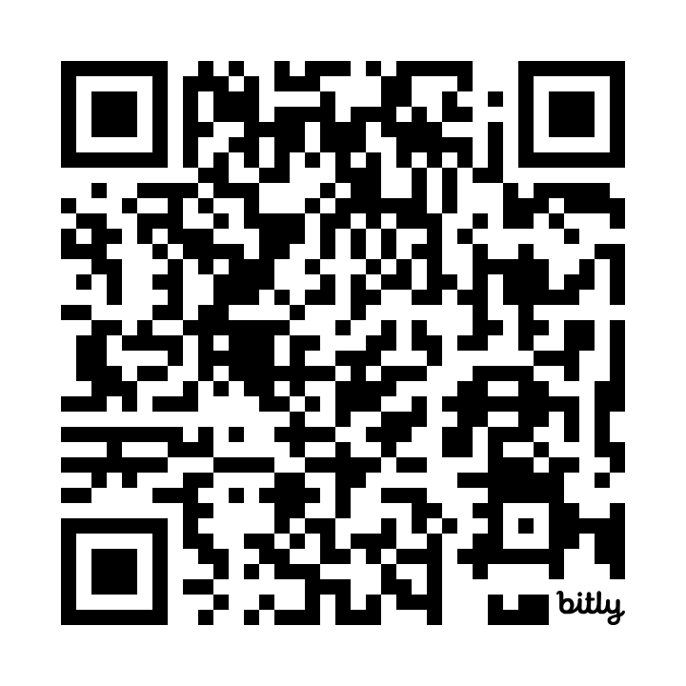
Supporting this research project
Assist with disseminating and sharing the online survey
Complete and submit the online survey
Assist with dissemination of findings
oc.lc/shared-print-survey

Slide 23
Remaining project timeline
Disseminate online survey: Summer 2024
Close online survey for responses: 3 weeks after initial dissemination
Share findings: By end of 2024
Continue engagement through 2025

Slide 24
Complete the survey
Stewarding the Collective Collection survey
oc.lc/shared-print-survey

Slide 25
Partnering with the Partnership
Stewarding the Collective Collection:
An analysis of retention data in the US and Canada
Collective print monographic holdings across Partnership
Coverage by shared print retention commitments
Report disseminated fall 2024
+
Notes:
One last note: I'd like to mention another project that's underway at OCLC having to do with operationalizing collective collections in a monographic shared print context. For this project, we're working with the Partnership for Shared Book Collections, and the goal is to identify the pool of print monographic materials across the Partnership that needs stewardship attention within a shared print context, and then identify what’s currently covered by retention commitments and what is not. This analysis will help optimize decision-making and priorities on retention commitments, and OCLC is excited to be working with the Partnership on this project. We expect to release a report on our findings later this year.

Slide 26
Questions and discussions

Slide 27
Thank you.
Lynn Silipigni Connaway, Ph.D.
oc.lc/shared-print-survey
Executive Director, Research
connawal@oclc.org

