Slide 1
Who Gets What and Why:
Moving EAST Collection Analysis Forward
PAN Forum, June 28, 2024
Notes:
https://docs.google.com/document/d/1ZqcSKtanYQMVsjjyGVhmjgJuO1iCMrs5AlYAfe4lSWY/edit?usp=sharing
Hello, for those of you who don’t know me my name is Sara Amato and I’m the Program Manager for the Eastern Academic Scholars’ Trust. I was asked to talk today about EAST’s most current collection analysis and some changes to our methodologies as EAST has grown.
I’ll also talk briefly about some of the challenges we are seeing both with collection analysis and existing retentions.

Slide 2
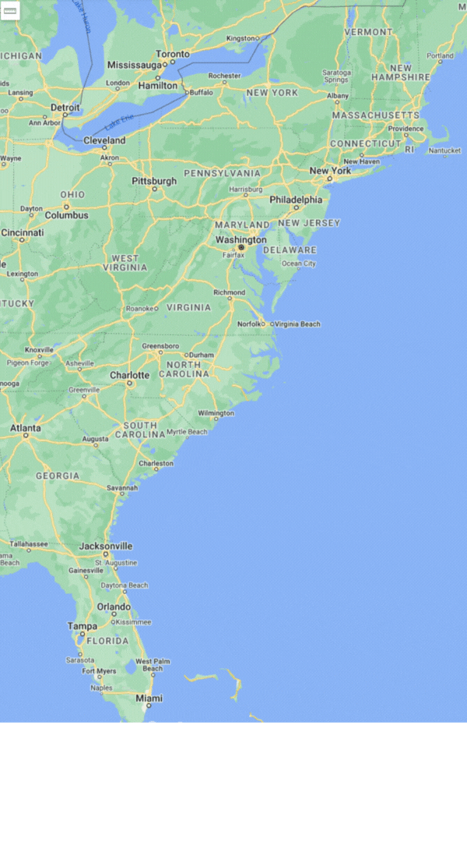
170+ Members in 15 States
Most are Monograph Retention Partners
32 Serials and Journals Partners
Over 11 million monographs & 37,000 serials and journals currently retained for initial period of 15 years
Retention commitments registered in WorldCat and the PAPR databases
Member of the Rosemont Shared Print Alliance
Founding member of the Partnership for Shared Book Collections, now the Shared Print Partnership
Notes:
This is just a quick slide that shows how EAST has grown from our original 40 members in our first cohort back in the mid teens, to over 170 members as of last week. Part of the growth is due to a new member model that allows consortia to join as a group, with their flagship schools joining as retention partners (that is those who retain materials for EAST, shown as the red dots on the map) with their smaller and perhaps less well resourced schools joining as supporting partners (those are the blue dots), with dues for those members based on their ILL activity. Of the 170+ members, 119 are currently retention partners.

Slide 3
Collection Analysis: Initial Program Analysis
All retention partners participate in Collection Analysis upon joining
Unique to EAST
Low number of copies in EAST
Local priorities - subject area, high circulation
Notes:
I’m going to talk a bit about the collection analysis process in EAST, the tools we’ve used, some of the challenges we’ve had and what we’ve been up to lately to refine our collection analysis both in light of rapid growth and also increasing reluctance we are seeing to continue to retain certain types of materials.
New members have the choice to use either GreenGlass or Gold Rush for their collection analysis, and we currently have members using each. One of the reasons we can do this is that all EAST retentions are registered in OCLC and thus visible in GreenGlass, and EAST also maintains a subscription to Gold Rush where our libraries maintain a retentions database. This means all EAST retentions are available in Gold Rush for comparison purposes. GreenGlass is more fully featured, but Gold Rush is significantly less expensive and does suffice for most of our purposes.
In general the EAST retention model has been to retain all material identified as UNIQUE to EAST, and then also asks new members to consider ‘topping up’ EAST retentions on titles where EAST holds fewer than 5 copies, so they can help us reach that 5 copy threshold. We also encourage new members to consider other types or criteria for retention that may be of local priority, e.g. subject collection strengths or perhaps recent circulation activity.

Slide 4
Collection Analysis: Data Points
67 libraries analyzing newer monograph titles (2011-2021)
Notes:
(This slide is for Ian, who traditionally at this point would ask “how did you choose 5 as the number of copies, which I’ll get to in a moment.)
So while all members underwent an initial collection analysis upon joining, over the last year EAST has taken on a group project analyzing newer titles. Theses are titles that were published or acquired between 2011 through 2021. EAST’s original cut off date was 2010, so this pulls in another decade of materials. This was an ‘opt in’ project for our retention libraries, and 67 libraries agreed to participate. We used the Gold Rush tool for this analysis, which kept costs relatively low for the participating libraries.
We had a working group meet regularly over several months to discuss a retention model for these newer titles, for example if there were multiple copies, how many should we allocate for retention, and to whom? Also what data points should be taken into consideration or at least provided to libraries, e.g. is there a digital surrogate in the Internet Archive and/or HathiTrust and what is its copyright status (again these were newer titles so the assumption was that even if a copy was in HathiTrust the digital copy would NOT be available to most members.), also discussed was if we should take WorldCat holdings levels into account, as we were able to glean some insight into those via the OCLC APIs.
The Working group also took a look at the recent article in College and Research Libraries on the ‘model to determine optimal number of monograph copies for preservation in shared print programs’. This model allows you to play with variables such as the age of the material, the storage conditions of the materials (e.g. is it in open stacks or in a climate controlled storage facility) and the time horizon - that is how far into the future do you want the model to look - 10 years? 50 years? 100 years?, and also a confidence variable (how confident do you want the model to be in the number of copies that it suggests.)
This was, for me, the most interesting conversation we had with the working group, as we had to do some future thinking - how do we see this playing out? How far into the future do we expect to want to commit to print and what does that mean for our member libraries. In the end they settled a 40ish year time horizon, which may sound short to preservationists, but looking back 40 years, that was pre kindle, pre ipad, pre smartphone - and OCLC was still printing catalog cards for some libraries. On settling on this 40 year mark the group felt that it would assure that a print copy would be around for the next generation or two and their technology, thinking that each generation brings its tech to print - we can look back at microforms, CD-Roms, and now e-books - what technologies will come along next, and it is important to have a print copy around for that next generation to apply their technology to it.
With the assumption that all EAST materials are held in open stacks, the model suggested that 3 to 4 copies would be sufficient for that 40 year time horizon with an above 99% confidence level. Note that this number is purley looking at this from a preservation perspective, and not if there are enough copies for access, which is a separate conversation we could have. Given that that new titles don’t stay in the ‘new’ category forever, and that EAST had an existing model of ‘up to five’ copies of certain types of material, that is what the group settled on. Also, In the end we included information on digital surrogates and WorldCat holdings in reports given to libraries, but did not make any recommendations on how those should be used, nor did we use them when assigning potential retention commitments.
—-------------------------------------------------------------------------------------------

Slide 5
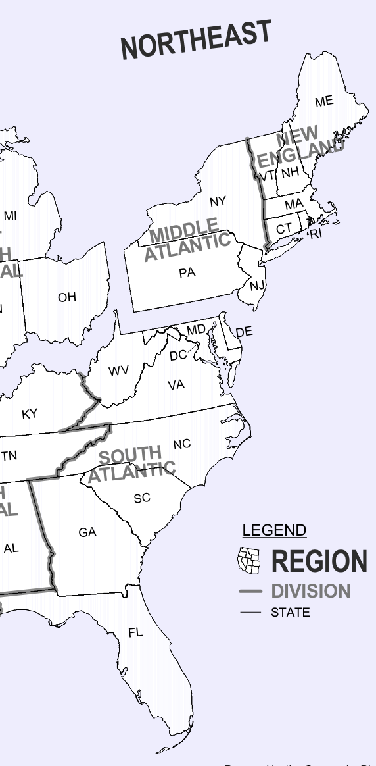
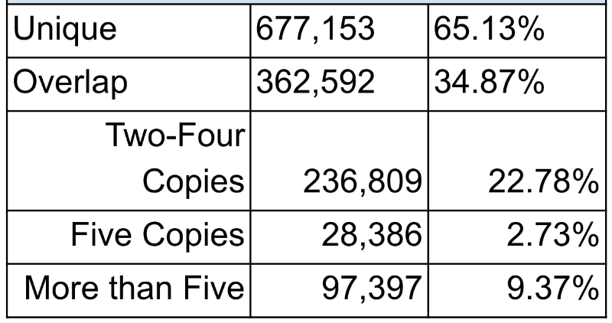
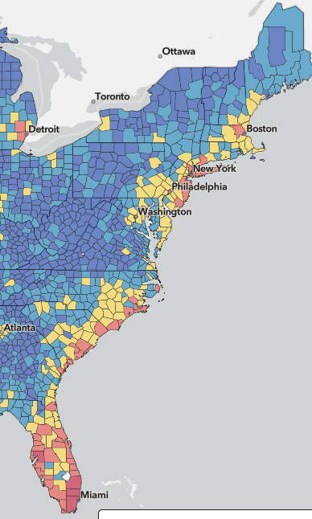
Collection Analysis: Allocation Options
Majority Held by One
Fewer than 10% held by more than 5
Allocation Priorities:
Prioritizing region (North/South)
Assigning to lower % libraries
Previous Consortial Models:
Subject Areas
Consortia ‘flagship’ schools
Fema National Risk Index https://hazards.fema.gov/nri/map
Notes:
Okay, here’s the fun part.
One of the upsides of Green Glass for Groups is that it will do the retention modeling AND allocations.
But we were using Gold Rush that has no mechanism for assigning retentions when the group holds more copies than the retention model calls for. An unexpected benefit of that was that we were able to think creatively on what we wanted that allocation to look like, assuming we had the data to apply it.
As you might expect, the majority of titles analyzed were held by fewer than 5 libraries. However, there were close to 100k titles that had more than 5 copies, and we needed to decide how to distribute the allocations. Given the geographic growth of EAST we decided to prioritize geography first, and, after looking at several maps settled on the US Census regions, and divided the allocation between North (New England and Mid Atlantic) and South (South Atlantic plus Tennessee as we have one TN library)
This worked well for us, as our first 2 cohorts were in the north, and continue to hold more retentions than newer partners. So if there was already a copy in the North, or more copies in the North, we prioritized a copy in the South. When deciding which library within a geographical area would receive the allocation, we the prioritized the library retaining the lowest percentage of their print collection.
This worked reasonably well, though there was at least one instance where the the library with the low % of retentions was for a reason - they had been a part of consortia where larger flagship schools took on more retentions and we had purposely previously diverted retentions from them when possible. That should have been taken into account this time but wasn’t. In the end they agreed to take on retentions in their areas of subject strengths and reject the others.
We think we are going to be seeing more of this with libraries focusing on their subject collecting preferences rather than the broad range of scattershot retentions folks agreed to when shared print programs first started out, and in fact when the VIVA consortia joined EAST we did do some subject preferences at a very high level when allocating their retentions.
We’ve also discussed, but have not yet used the FEMA National Risk Index map - small screenshot here with suggests we should be keeping things in Maine rather than Miami. We had one of our board members go through the geo locations of member libraries and assign the FEMA risk index to each member, so this might be something we dig into more deeply in the future. (E.g. additional copies of the Miami titles should not be on the coast…)
============================
4.2 million matched the retention model representing 850k distinct titles
https://www2.census.gov/geo/pdfs/maps-data/maps/reference/us_regdiv.pdf

Slide 6
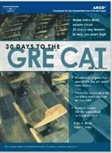
Collection Analysis: Scope
“Ephemera” - keywords and publishers, e.g. ‘for dummies’, ‘Prentice Hall’ …
Tips/Suspect - keywords in title, e.g. career, best, workbook
Juvenile Lit - 008/22 a,b,c or j for juvenile fiction or ‘juvenile’ in a subject
Board planning for retreat to discuss refinements, problematic titles, etc.
Notes:
Sara
Circling back to things libraries don’t want to keep, I wanted to talk a little bit also about our evolving Scope. EAST tries to exclude certain types of materials from collection analysis, e.g. test prep materials, old computer manuals, travel guides and in general types of things libraries are unwilling to commit to retain long term. We try to accomplish this in a couple of ways: first by running allocation lists through filters to remove certain publishers and also removing things based on keywords in titles, e.g. “For Dummies” titles. We’ve been doing this for a while and it works fairly well.
Secondly we have a ‘tips for reviewing your allocated retentions’ document that we’ve recently started using to call out proposed retentions materials that might merit a closer look. For example titles that begin with a number, as these MIGHT be things are out of scope, e.g. 101 ways to garden in the pacific northwest, OR they might be something like “1984” or 1000 arabic poems, things that we might want to keep. A few other keywords from that list are “Best”, “Manual”, and “exams”. We’ve put these titles on a “suspect” list that we ask libraries to pay extra attention to. We also have started flagging ‘juvenile’ titles based on the 008 position 22 (which is target audience) and/or if there is the word ‘juvenile’ in any of the subject headings. These are a really gray area for EAST, it is up to our members if they want to commit to retain juvenile titles. This flag also catches a range of materials, some clearly out of scope like paperback early readers like “Let’s go Eat!” vs more young adult and graphic novels that would be more appropriate for long term retention commitments. We are hoping just flagging these titles will help draw attention to them for extra scrutiny when reviewing proposed retentions.
In the past we’ve had some members who accepted all of their retention allocations without much review, both due to staff constraints or the sheer number of retentions proposed, who are now regretting that - sometimes due to now doing an inventory and finding materials they would have preferred not to retain, or changes in leadership and staffing and finding that they ‘inherited’ a large number of retentions that is constraining their ability to manage their collections effectively. This is something we are just starting to dig into, and will be having continuing discussion about with our board and operations groups.
Another area of scope that we are also just starting to grapple with is offensive or problematic material that some libraries don’t want to retain, but which have a current retention commitment. We’ve had members approach us with material that the really don’t want to keep in their open stacks and would prefer to withdraw, while other members tell us that they will intentionally collect and contextualize this type of material and see it as historically important, and members should live up to their commitment to retain items allocated to them. At the moment we have an ad hoc process where we will try to rehouse materials, but think this is something we feel we should have a clearer statement on and process for.
The EAST board has been discussing a planning retreat with our new director who starts this summer to start to dig into these issues. Stay tuned!

Slide 7
Special Collections
Notes:
And finally, one last quick thing on our current collection analysis, We also had 5 libraries participate in analyzing their special collections. While some libraries tell us they automatically keep everything in their special collections, others have more flexible collections and do want to see their collection comparisons. While we didn’t do our traditional analysis and recommendations of retentions with these, we did provide the libraries with custom reports they requested including the overlap of their stacks with others special collections to see if there were things they might want to consider moving to specific collections. This is still a work in progress and we are meeting again with this group later this summer and might have more to say about it then.

Slide 8
Future Work and Challenges
Members:
Refining & extending commitments - beyond 2021, Special Collections, ‘right-sizing’ & more!
“One library’s dog is another’s cat”
Collection diversity
Data & analysis on ILL activity of retained titles
Commitment to resource sharing - but what of CDL?
Long-term strength of MOUs
Program:
Communication
Staffing issues at members
Changes in leadership and staff
Resource Sharing systems / relationships
‘Retention Burden’
Notes:
This is just a quick list of challenges we know we will continue to face, along with a list provided by one of our members we recently presented with at ACRL NE.
On the programs side:
Communication with member libraries - we have some super engaged libraries and others where we struggle to maintain contact with
Perhaps relatedly are staffing issues - are there staff at member libraries that can assure that EAST policies are being followed
We constantly struggle to onboard new staff at member libraries, including deans and directors so that they understand the benefits of EAST to their library
Resource Sharing work, we had a task force recently make some recommendations on services EAST can improve, and also that we should be advocating with vendors for standards based systems so that the wide variety of platforms members use can interoperate
And finally the ‘retention burden’ that we are hearing from some libraries, where they are finding it increasingly difficult to maintain a large number of retentions on materials that may not fall into their current collection priorities.
On the Members side, some future work and challenges included the usual ‘whither retentions’ musing - what about newer titles, ‘right-sizing’ retentions (which I think is what I called burden but right sizing is a better term) - and they used what has now become one of my favorite quotes based on when a library asked about some of its retentions “how did we get stuck holding this dog?” they replied “on library’s dog is another’s cat (that they want you to keep”) . They are thinking about diversity of the collection and watching the SCELC/EAST work with interest, they are interested in both CDL (how is that going to play out in all of this) and also digging into statistics of ILL activity of retained titles (which is stupidly hard to get at!... I’m saying that to any vendors listening….) and finally they are musing about
the long-term strength of MOUs.

Slide 9
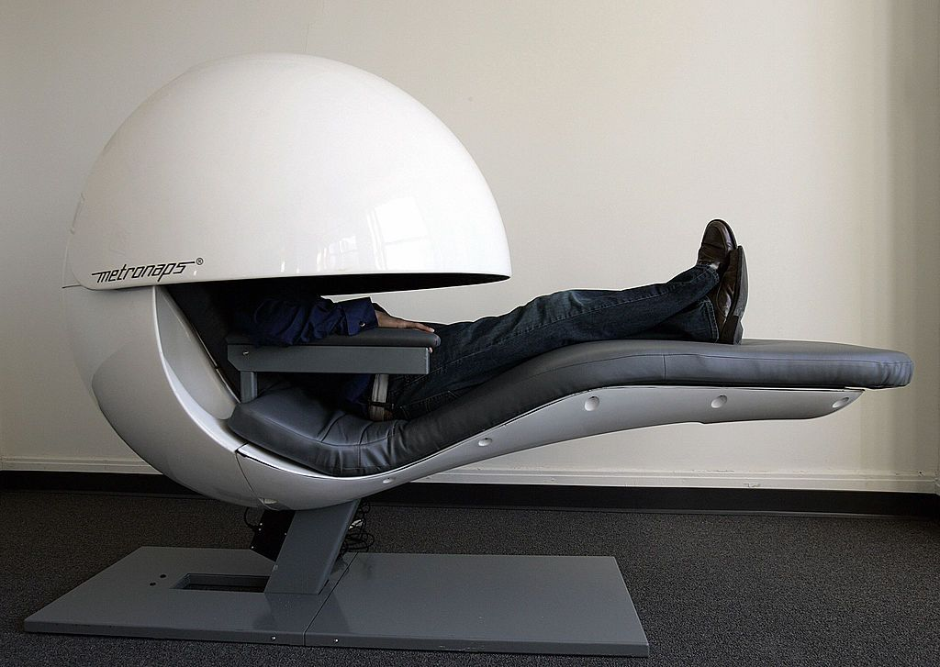
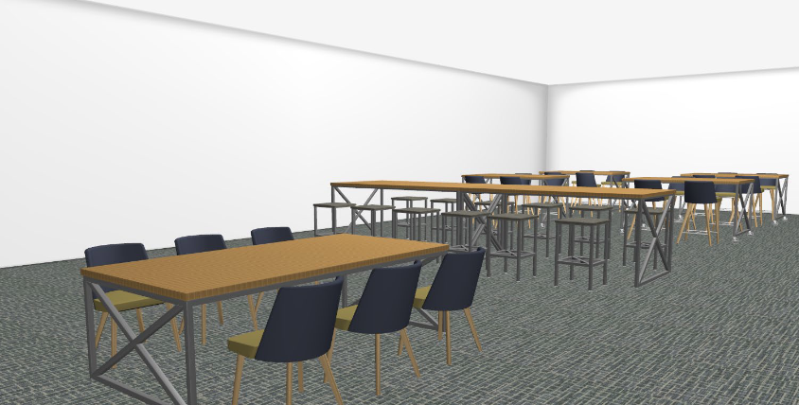
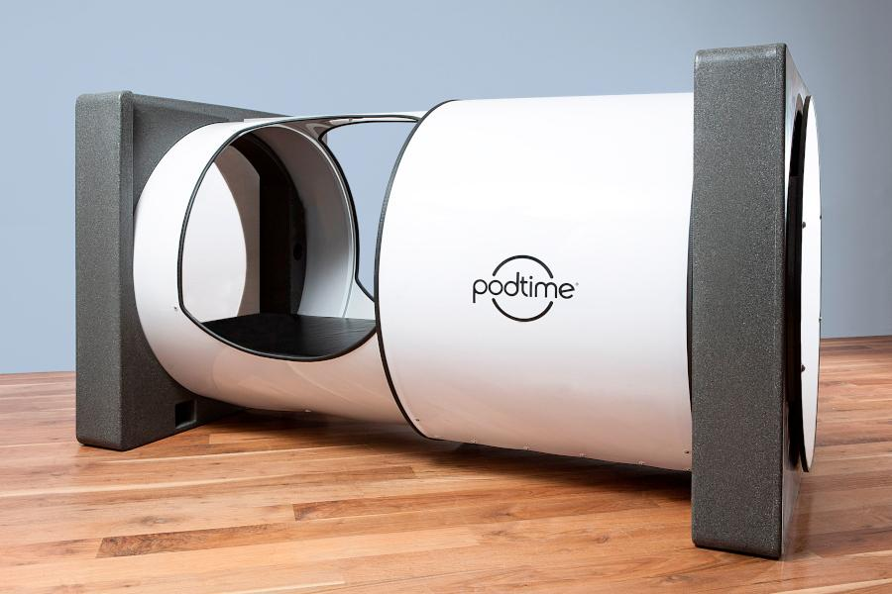
Future: North Carolina A&T
Our future is centered on expansion of services, offerings, and spaces:
Expansion of Storage-off site retrieval option
Expansion Funding Received
MakerSpace
Data Science Lab
Space for Sleeping Pods (Grant Funding)
Also additional funding to expand our Archives
Prominent Archival Collections
Named Reading Rooms
Reorganization of roles based on need for Archival expertise
Notes:
And with that I’m done expect I had to throw this in here as an example of what one of our members is doing with reclaimed space - napping pods!
Personally I’d like to work in this bubble with a surrounding screen….

Slide 10
samato@eastlibraries.org
matthew.revitt@maine.edu
Questions?
Notes:
Sara
Thanks so much for your time today. What questions might we be able to answer for you?

