Slide 1





SCELC: Statewide California Electronic Library Consortium
EAST: Eastern Academic Scholars' Trust
Slow or FAST: Diversity in Shared Print Participation at SCELC & EAST
PAN Annual 2024 - Project Update
June 28, 2024
Sara Amato, Program Manager, Eastern Academic Scholars’ Trust, Teri Oaks Gallaway, Executive Director, SCELC
Jason Price, Director of License and Open Access Services, SCELC
This project was made possible in part by the Institute of Museum and Library Services (LG-252402-OLS-22). https://imls.gov/
Este proyecto ha sido posible en parte por el Instituto de Servicios de Museos y Bibliotecas, (LG-252402-OLS-22). https://imls.gov/
Notes:
Susan
- welcome
(should be everyone on the CC other than Tracy)

Slide 2
1
Project importance and status
Agenda
  2
  Community Council outcomes
  3
  FAST approach
  4
  FAST findings preview
5
Future work
Notes:
Susan
Here is the agenda for today:
- Following this welcome I will turn it over to Teri to provide an update on the status of the planning grant. We’ll focus on the 3 major goals and the projects that have been initiated in order to meet that goal, giving you an update on where we are.
As we review our progress against each of the goals, we will be identifying the challenges we have encountered and, based on progress to date, expectations we have for specific recommendations we will be making as part of our final report. Following EACH update on our progress against the goals, we will be asking for your feedback during a discussion period.
- As our final planning grant goal is focused on dissemination of the project’s results to the larger shared print and MSI library communities, we’ll take some time to seek your counsel on the most effective venues and formats for such dissemination
- And although we only have an hour for today’s call we’ll do our best to leave time for any final questions or comments at the end.
- With that, I’ll turn it over to Teri to kickoff the project update. Teri…

Slide 3
SCELC, EAST, and the Community Council will identify ways to expand MSI participation in SPPs by understanding and communicating the value proposition of SPPs for MSIs as well as by designing solutions for overcoming barriers to participation.
Status: Completed
Challenges: Stewardship vs. Access, Ending of Retention Committment Periods
Final Report and Future Recommendations: Focus on Digitization and Access Models
Goal 1
Update
Notes:
Teri
Status: Expanded outreach with messaging focused on barriers to participation in shared print by HSI's and HBCU's - with examples from SCELC and EAST
Challenges: Tensions between preservation and access. What is the value of participation for MSIs if they already hold diverse collections that other PWI communities may want to access and also be asked to retain materials that they do not desire to keep. Stewardship at three levels must be considered-at the institutional level, as a participant in an MSI community, and for the greater good of the library/scholarly community.
Final Report and Future Recommendations: Focus on Digitization and Access models is critical for safekeeping of collections and value of participation. Recruitment strategies need to address both the importance of stewardship at all levels and the benefits, which must outweigh the cost and effort. As will be discussed in Goal 2, retention commitments of diverse collections are not sufficient for preservation. A focus on digitization and CDL is an incentive for participation. As programs reach the end of their initial retention commitment periods, what will happen to the materials and are they at risk of being lost.

Slide 4
Community Council Response to Results of Shared Print Program Assessments
CONTEXT
The Community Council, comprised of library leaders from MSIs, is responsible for advising on and providing oversight for all project activities. The Council reviewed the results of the Shared Print Program Assessments, and through structured inquiry, shared additional perspectives to assist in analysis of barriers to the adoption of shared print by MSIs and in assessing the value shared print brings to MSIs.
1
How should SCELC and EAST approach this work to support MSIs and minoritized communities?
4
What solutions or opportunities should be explored?
Expanding participation and building expertise through existing trust networks like consortia.
Listen, Ask, Learn about Backgrounds, Invite, Empower, Be Respectful
"Instead of designing for people, you include people in the design process..."
"We have this catalog of experts,...people in various institutions who are experts in various issues. And if any of us is having an issue or that issue, we can call on that expert..."
2
What is the importance/benefit of shared print for MSIs?
Preservation, Access, Learning, and Networking
5
Is there a need for organizations like SCELC and EAST to focus on program expansion to include MSIs or should other organizations build new opportunities for MSI participation in shared print?
"These collections are about human knowledge, preservation of human knowledge, and the sharing of human knowledge."
What are the barriers to participation for MSIs?
Both regional and larger scale collaboratives and MSI-focused programs have benefits and need to be balanced based on collection needs, strength of existing trust networks, and the overall purpose of participation.
3
Staffing and expertise are important, as well as building trust in the community.
"Maybe there's a trust issue sometimes when [MSIs] are dealing with larger institutions. It's just a barrier...to build relationships, thoughtfully."

Slide 5
Through the addition of four new MSI program participants, SCELC, EAST, and the Community Council will research the impact of MSIs on collection diversity. Program staff will support onboarding of new participants and research staff will support projects that test diversity audit strategies including bibliographic analysis.
Status: In Progress
Challenges: Limited bibliographic analysis tools, Onboarding requires time committment from participants
Final Report and Future Recommendations: Focus on FAST strategy, retrospective retention committment modeling
Goal 2
Update
Notes:
Susan
Following our meeting with you late last fall, SCELC and EAST extended calls for participation to new MSI’s for their respective communities. Linda and I will be discussing this in a bit more detail following Jason’s update.
As you’ll hear, we had and have some challenges in our collection work: in some cases the metadata itself created limitations as did the tools available to do the analysis.
Many of the libraries we are working with are small and have staff with limited time and in some cases minimal expertise to work with a shared print program. On the EAST side, for example, we needed to work closely with two of the HBCU libraries to ensure they could export records from their local systems and then finding many of the records lacked the necessary OCLC numbers to facilitate comparisons, we worked to enhance the records to best ensure a comprehensive analysis.
Both of these have delayed some of our work and limited the conclusions we can draw from that analysis.
As you heard in our last call when Jason introduced some of our research to you, we determined that using FAST – or Faceted Application of Subject Heading Terminology – provided the most reasonable approach to analyzing the diversity of a library’s print collection. But, as Jason will describe, just identifying the correct FAST headings to use required an investment of those with expertise in metadata, which can be challenging.
As we look to complete the research in the coming months as well as the collection analysis for the individual new libraries, we want to apply what we’ve learned in our FAST analysis to the retention models as well as consider ways to apply this work to the existing retention commitments across not only MSI institutions but all of those engaged in shared print.
Let me turn it over to Jason now to discuss this research in more detail.

Slide 6

FAST Approach
1
Faceted metadata based on LCSH
FAST
  2
  How is FAST metadata applied?
(Faceted Application of Subject Terminology)
  3
  More flexible than subject heading analysis
Example LCSH Headings under FAST African Americans:
  American literature -- African American authors
  African American Churches
  African American women doctoral students
  Expartiation -- African Americans
  Older African Americans
Notes:
The collection analysis tool used in this work is OCLC’s Choreo Insights, which allows for the use of FAST subject headings. FAST headings are derived from Library of Congress
Subject Headings, but distill the over 26 million LCSH headings down to under 2 million FAST headings. This creates a kind of “shortcut” for subject analysis.
FAST headings are automatically applied by OCLC on any records which have LCSH headings.
(This means that 75% of materials in WorldCat are ‘fastened’). You can see an example Marc 650 field with a ‘fastened’ heading of “African Americans”. Using the FAST heading “African Americans” pulls in all related LCSH headings, including when the term is in a subdivision of the LCSH heading, for example 'expatriation – african americans’ or “American literature – African American authors” or even terms such as “Older African Americans”.
While FAST headings do suffer the same biases as LCSH headings, using FAST is more efficient, and just plain FASTer, than working with LCSH headings.
(80 seconds)

Slide 7
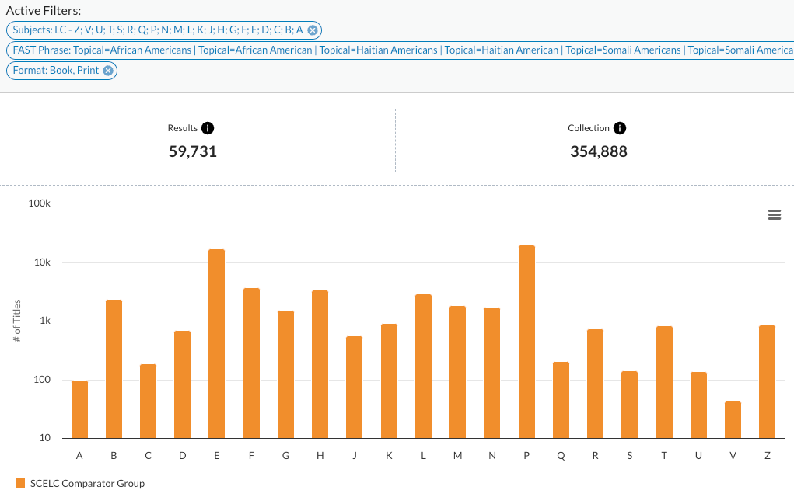
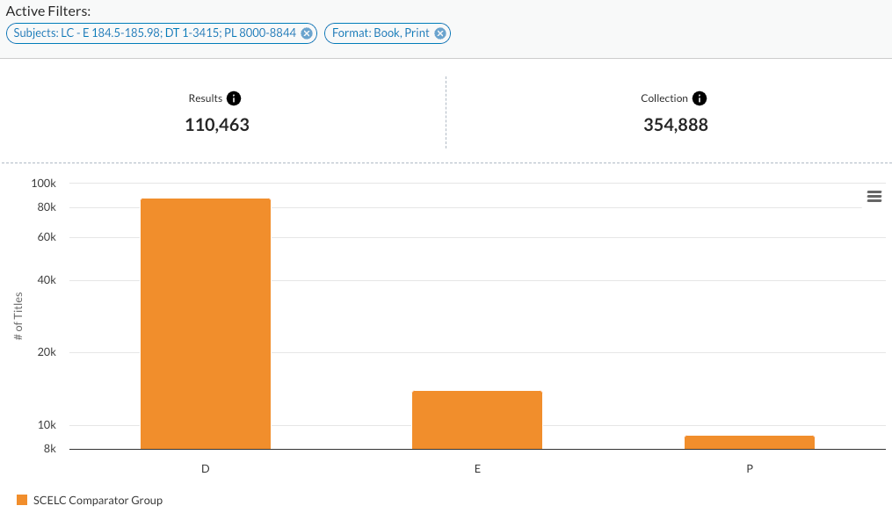
FAST is a vast improvement over LC Class/LC Range-based Diversity Assessment
DT1-3415: History of Africa
E184.5-185.98: Afro-Americans
PL8000-8844: African Languages & Literature
D
E
P
Range Recommendation From:
University of West Florida | University Libraries
Diversity Collection Audit & Assessment
https://libguides.uwf.edu/divassess/aa
EAST(96 Institutions))
Notes:
We also found that using FAST headings was a vast improvement over using LC class ranges for DEI work. Although the LC Class/Range approach identified 2x more books, the books matching FAST subject headings were across the LC spectrum and more relevant. Obviously if you are using Class Ranges to identify diverse materials, you are only going to find materials in those LC ranges, and miss out on titles related to your target group that fall outside of those ranges. As an example here, targeting african american materials, using FAST headings of african american/s, haitian american, and somali americans you find materials across the LC class spectrum, and in general materials those materials surfaced are more closely related to your target than you would get by using the narrower LC class search.
(50 sec)

Slide 8
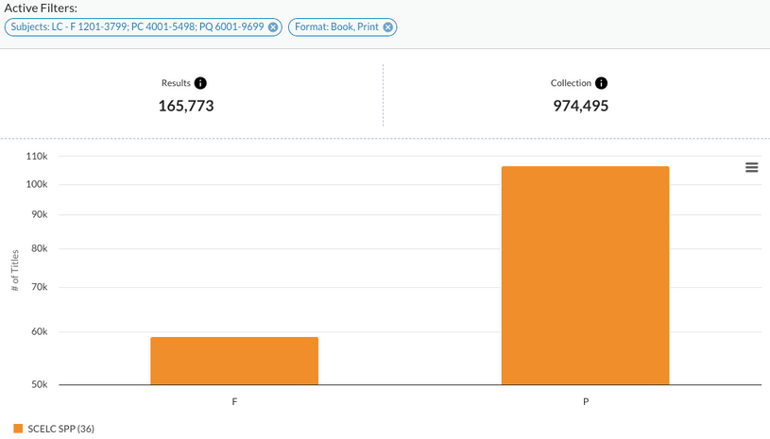

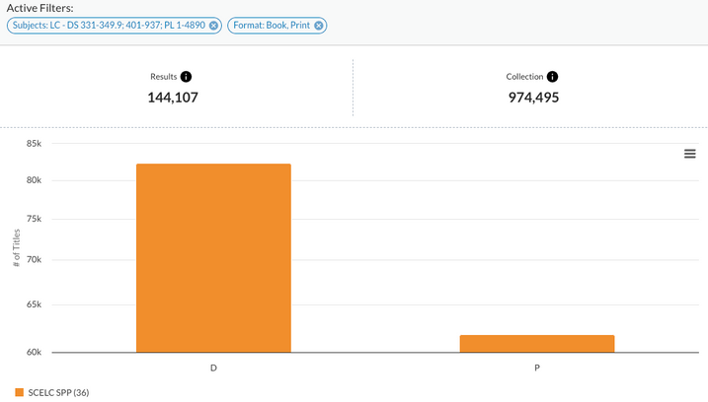

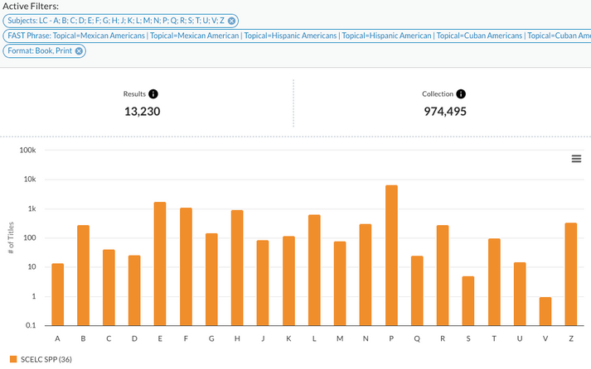
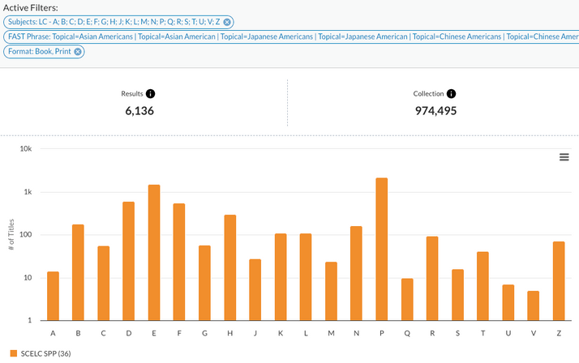
FAST is a vast improvement over LC Class/LC Range-based Diversity Assessment
‘African / African American’
‘Hispanic / Latinx’
‘Asian / Asian American’
D
E
P
F
P
D
P
EAST (96)
SCELC Shared Print (36)
SCELC Shared Print (36)
Notes:
We saw this play out across the three target groups (african american, hispanic and latinx, and asian american and pacific islanders) with the related FAST headings surfacing relevant materials across the LC class ranges for these groups.
(15 sec)

Slide 9
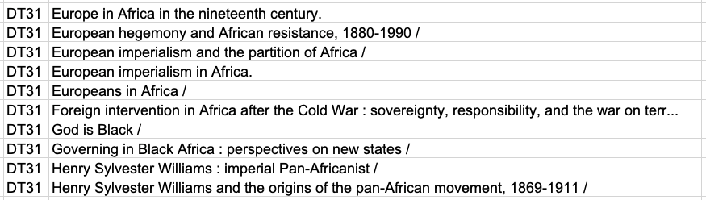
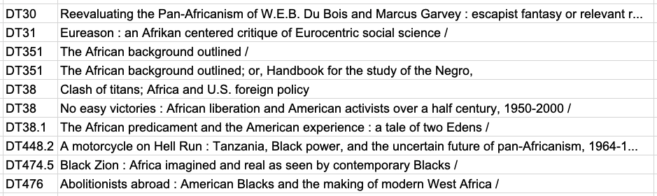
HBCU #3 Sample of LC Range DT 1-DT 3415 ‘Diversity Assessment’ Titles (1001-1010)
HBCU #3 Sample of 10 FAST titles bracketing the same range
Notes:
And this is just a quick example showing that the FAST results are much more likely to be related to your target group than the LC Class search gets you.
(15 sec)

Slide 10
OPTIMIZE DIVERSITY ASSESSMENT STRATEGIES
Research Questions
In progress...
  Books about the community - FAST
  Broadening our perspective

Slide 11


Research Questions
1
Do MSI book collections reflect the communities they serve?
  2
  Do MSIs own books about their communities that are not held by other shared print participants?
  3
  Do MSI retention commitments reflect the community they serve?
Notes:
Jason
Questions that our grant reviewers recommended we get answers to.
We designed the study around them and are working hard to get the best possible answers we can.
At the same time, we feel like any accurate answers no matter how limited are a significant step forward.
And rather than start with the limitations, we decided to present the preliminary results right up front, so here we go...

Slide 12
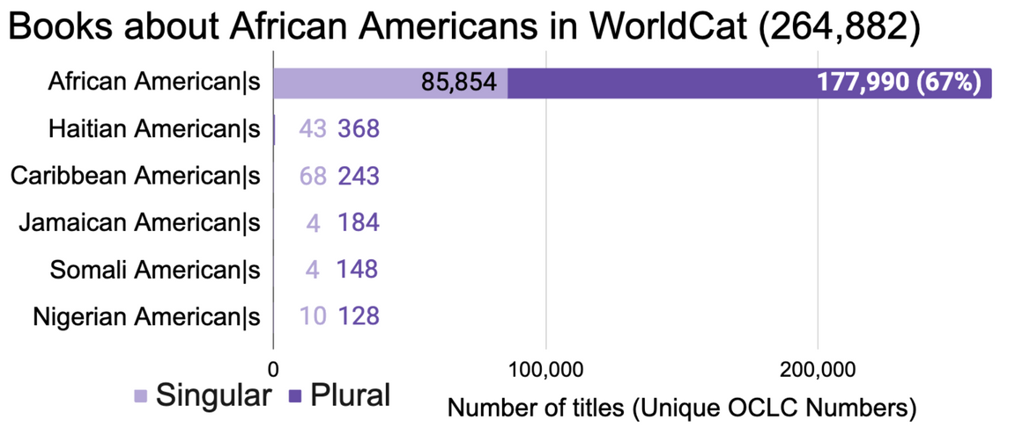
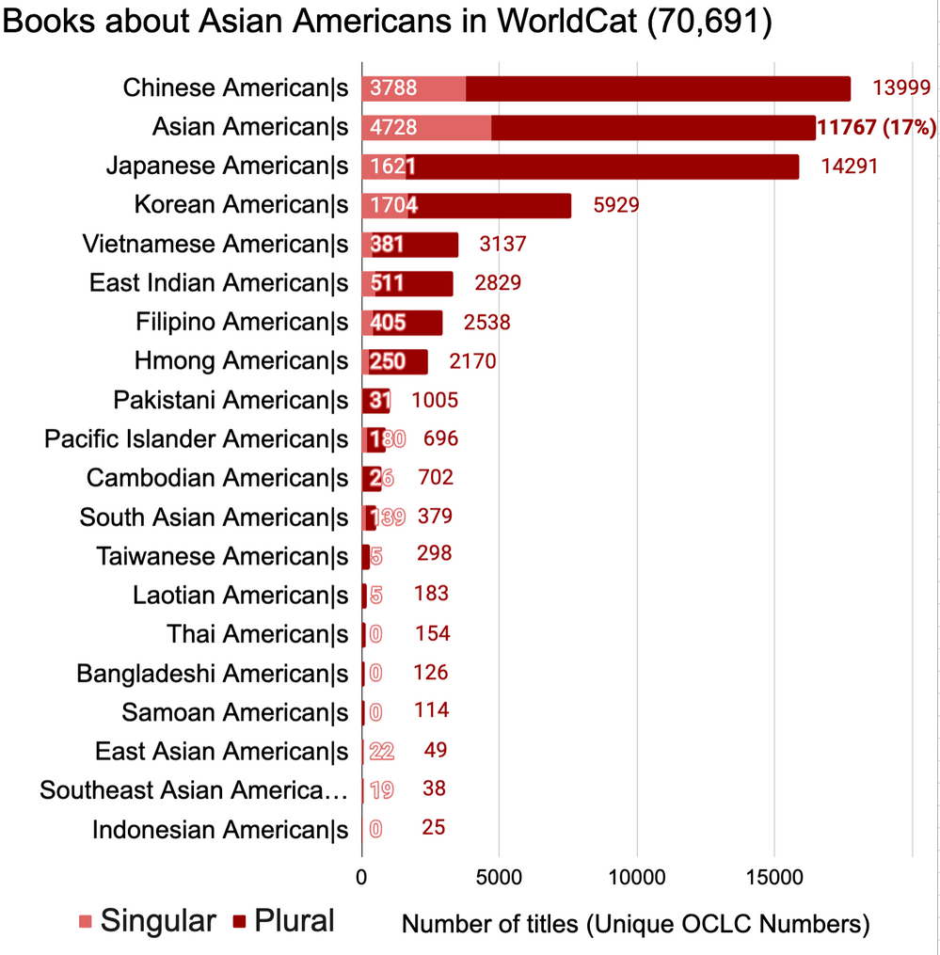
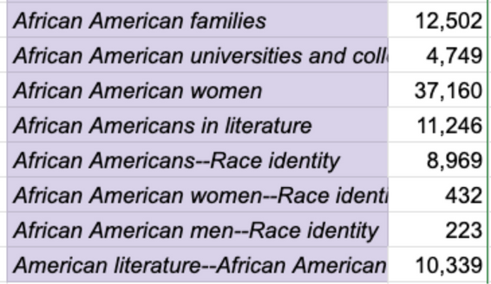
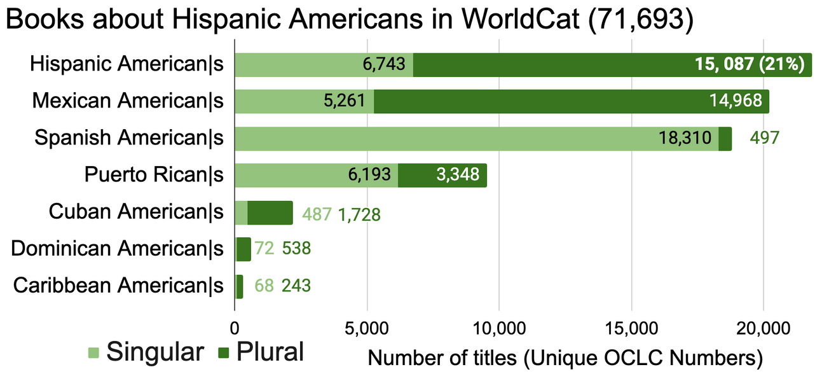
Fast Headings used to Identify Books about Historically Marginalized Communities

Slide 13
Preliminary Results*
1
Do MSI book collections reflect the historically marginalized community they serve? Yes, 2-4x higher proportion of total
  Do MSIs own books about their historically marginalized communities that are not held by other shared print participants? Yes, 2-6x more than PWIs but still very small numbers (10-100*)
  2
  3
  Do MSI retention commitments reflect the historically marginalized community they serve? TBD (in line w/ ownership?)
Notes:
Jason

Slide 14
  But...shouldn’t we be asking these questions from a different perspective?
  2
Rather than focusing on what MSIs can bring to a shared print program,
We can ask what benefits the program can provide for MSIs
  What books about historically marginalized communities (HMCs) do we have in common?
  What books about HMCs do members of the program own that MSIs lack?
  What books about HMCs do we collectively lack?
  2
Notes:
Here is the final data slide

Slide 15
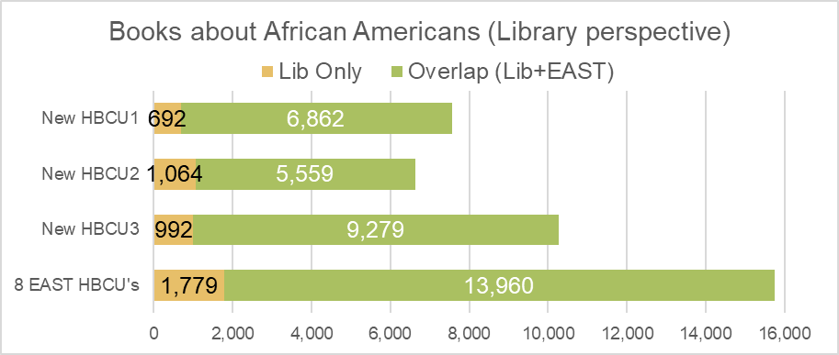
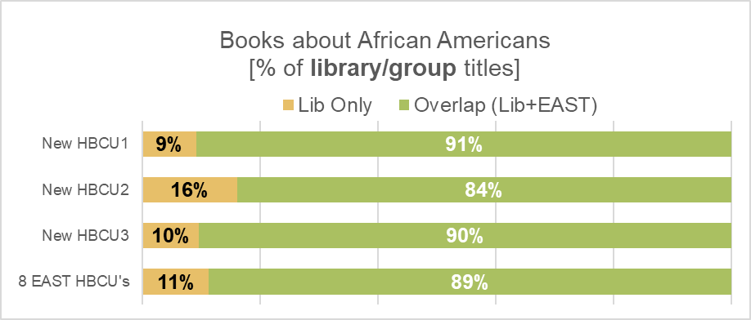

Slide 16
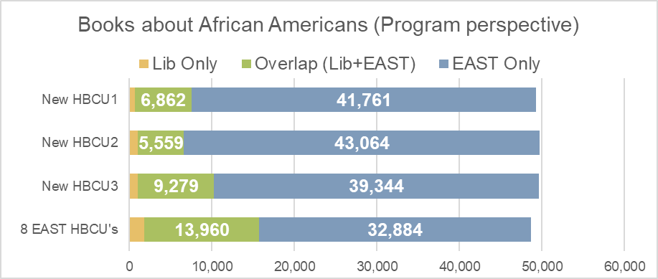
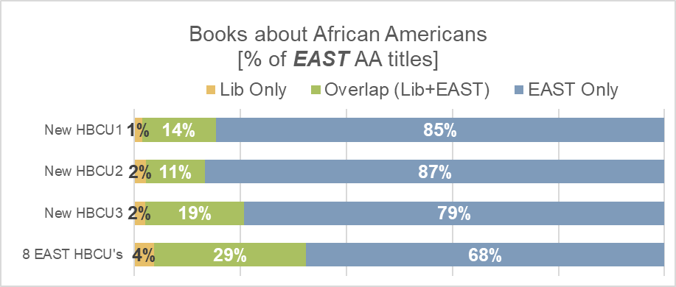
50,000 titles
= 0.4%
of all EAST titles

Slide 17
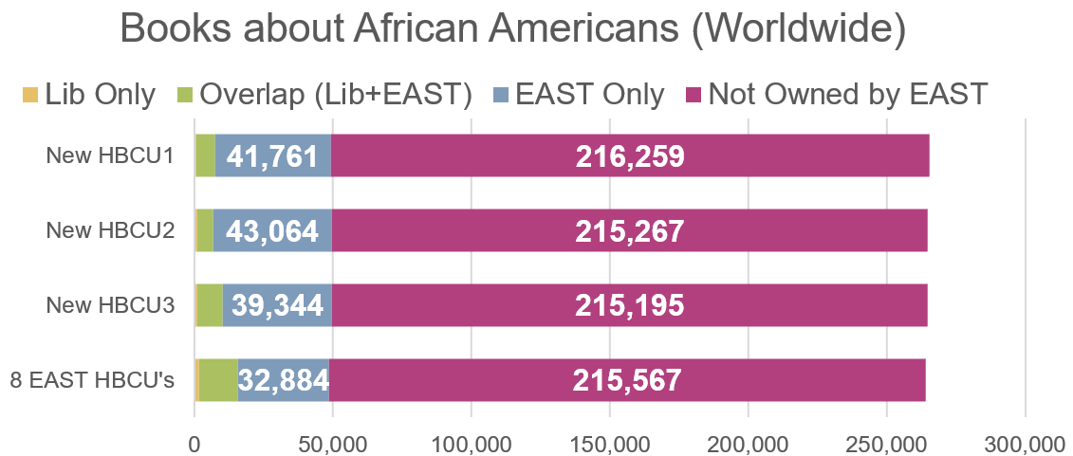
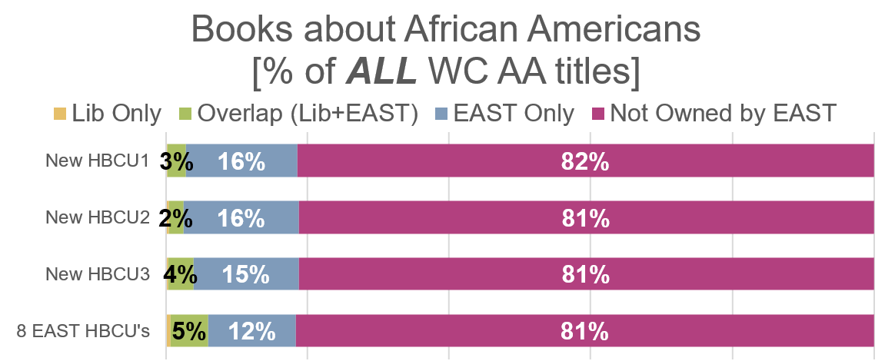

Slide 18
  A broader perspective
  2
  What can our shared print communities do to make all of the books about historically marginalized communities available to MSIs specifically and to researchers everywhere?
    Some Possibilities
      Cultivate & share lists for voluntary commitments
      Ensure 100% retention of these titles
      Consider retaining more (or even all?!?) copies
      Focus on lending and access
      Recruit libraries that own missing ‘about HMC’ titles
  2
Notes:
Here is the final data slide

Slide 19
Support Future DEI Focused Shared Print Initiatives through Project Dissemination. The findings of the Planning Grant will be shared broadly within the Shared Print and MSI Library community in order to support future research of collection diversity and to continue progress towards reducing participation gaps in SPP.
Status: In Progress
Challenges: Creating broader impact and planning a next phase.
Final Report and Future Recommendations: What can our shared print communities do to make all of the books about historically marginalized communities available to MSIs specifically and to researchers everywhere? How can FAST be a system agnostic tool for collection analysis. How to support engagement with and leadership from marginalized communites.
Goal 3
Update
Notes:
Teri
Status: Dissemination on the planning grant - PAN, ALA, Charleston Conference, public webinars, white paper, final report to IMLS.
Challenges: Grant team needs to further connect with CC to identify venues for dissemination
Final Report and Future Recommendations: Scoping the final report and deliverable to meet our deadline.
Current plans to share our results:
- to the shared print community through the Print Archive Network (PAN) forum next month at ALA Annual
- more widely to the library community through the Charleston Conference in November as well as community webinars
- and through a white paper on best practices to support MSI participation in shared print
Final Report and Future Recommendations: More community engagement around the selection of representative FAST subject headings for other MSI communities is needed as well as further work to encourage usage of FAST schema. FAST has not been part of the typical onboarding workflow for SPPs. Additionally, the group acknowledges a great opportunity for PWIs to utilize an adapted retention model that prioritizes safeguarding items using the FAST subject headings that represent MSI communities. Retrospective retention commitments could be prioritized as we identify the gaps in commitments made by both PWIs and MSIs. Advocacy is also needed to involve systems developers and groups like LOC to make FAST more available for collection diversity analysis work.

Slide 20
SCELC: Statewide California Electronic Library Consortium
EAST: Eastern Academic Scholars' Trust
Thank You!
Notes:
Susan
- any further comments or questions?
- BIG THANKS!
Teri?

