Slide 1
A Bridge to the Shared Print Partnership
Cabrillo Bridge, 1914
Aaron Krebeck - Washington Research Library Consortium

Slide 2
Roots of a Merger
Closely linked missions with overlapping work
CRL Summit
Merger Task Force
Hiring a Consultant
First Avenue Bridge, 1931
Notes:
The Partnership for Shared Book Collections and the Rosemont Shared Print Alliance have been in discussion for more than two years about the prospect of merging our organizations. Members of both programs identified several motivating factors for the merger:
They have closely linked missions.
both specialize in shared print, one for books, one for serials
There is a desire to eliminate duplication of efforts and to leverage efficiencies of scale.
There is a desire to coordinate the work of regional shared print initiatives in the U.S. and Canada; many of these initiatives work with both books and serials.
This merger will facilitate the development and management of a coherent bi-national strategy to address outstanding challenges with shared print. These challenges include community-controlled infrastructure for tracking retention commitments, allowing for retention data that is open to all, and an understanding of the universe of unarchived print materials, especially the development and implementation of plans to preserve and provide access to this material. Background documentation on the merger includes
The Report of the Joint Rosemont–Partnership Task Force for Future Strategic Consolidation (April 2023)
The Report of the June 2023 Summit on the proposed merger
The Shared Collections Merger Implementation Task Force Consultant Report (April 2024)

Slide 3
Merger Task Force
Spruce Street Suspension Bridge, 1912
Outlining a statement of purpose and value proposition
Identify key questions and recommendations for new organization
Bridge Year Proposal
Notes:
The merger task force was made up of two representatives from each of the Executvie and Operations Committees for both organizations. Its first step of the merger task force was to hire a consultant. We engaged Sarah Cohen of the Big Questions Collective to lead us through a multi-phase approach to determining what a merged organization should look like. Work started at the tail end of 2023 and began with drafting a statement of purpose and value proposition. Meanwhile our consultant conducted interviews with select stakeholders and shared print participants. That group then analyzed this feedback and finalized recommendations for the new organization and identified some key outstanding questions that will need to be addressed. In order to move work forward but also provide a discussion space for solving some of the remaining issues around scope and goals, the Task force proposed a bridge year. That Bridge Year will begin on Monday July 1st

Slide 4
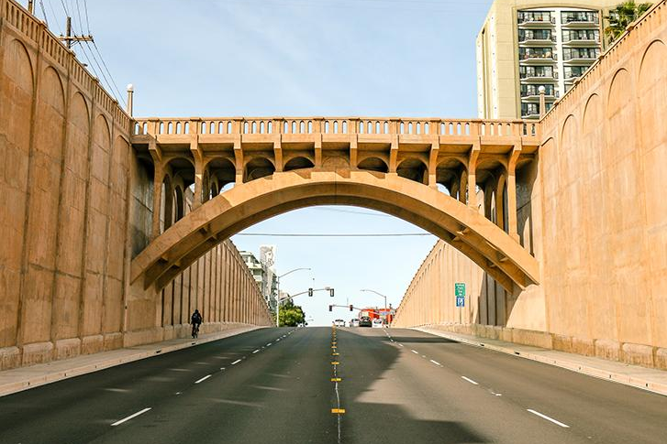
A Bridge Year
Establish Governance Structures
Strategic Planning
Stakeholder Engagement
Communication and Community Involvement
Georgia Street Bridge, 1914
Notes:
Bridge Year Plan:
Establish Governance Structures:
Develop and approve bylaws and organizational processes.
Complete the recalibration of existing committee charges, activities, and work plans to align with the merged organization's needs.
Strategic Planning:
Conduct strategic planning sessions to develop a mission, vision, and values for the organization.
Use the outcomes to align resources and activities with the organization’s theory of change.
Stakeholder Engagement:
Engage with current, past, and potential stakeholders to refine the organization’s strategic direction.
Utilize feedback to adapt and enhance organizational strategies and practices.
Communication and Community Involvement:
Implement a comprehensive communication strategy to keep members informed and involved in the transition process.
Invite contributions from a diverse range of voices to ensure broad representation and buy-in.

Slide 5
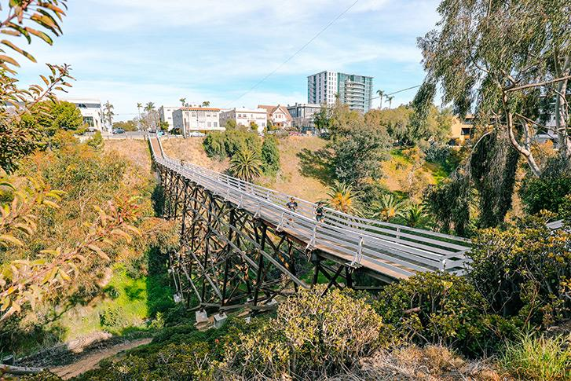
Next Steps
Quince Street Bridge, 1905
Volunteers Wanted
Key Decisions
Membership and Fee Structure
Staffing and Leadership
Program and Service Development
Governance/Committee Roles
Notes:
Key Decisions for the Executive Committee:
Membership and Fee Structure:
Decide on the membership fee structure and rates for the initial years.
Determine the benefits and responsibilities associated with various membership tiers.
Staffing and Leadership:
Address the need for executive or director-level staffing to manage ongoing operations and strategic initiatives.
Consider the structure and staffing needs of the organization to support its goals and activities effectively.
Program and Service Development:
Evaluate and prioritize new and existing programs and services to be developed during and beyond the bridge year.
Decide on the ROI of these services to ensure they contribute to the organization's membership and funding sustainability.
Governance and Committee Roles:
Finalize the composition and terms of the new governance committees.
Establish regular reporting and accountability mechanisms for all committees.

Slide 6
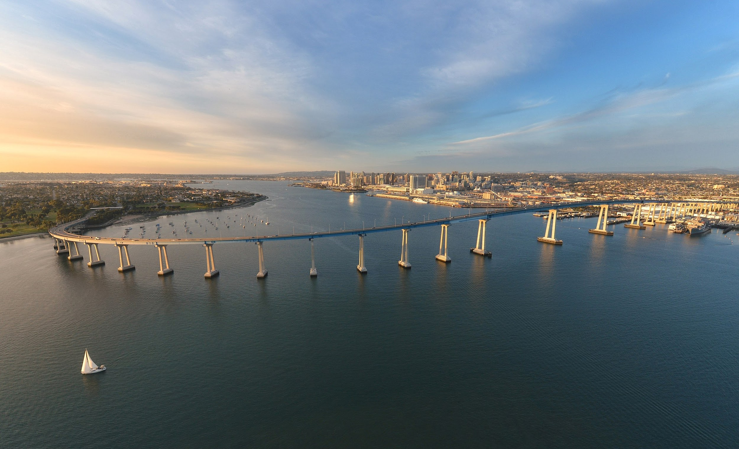
Thank You
Coronado Bridge, 1968

