Slide 1
PAPR is Evolving
Marie Waltz
Head of Access Initiatives & Collections Care
Center for Research Libraries
PAN Forum, 6/28/24

Slide 2
PAPR is an open platform with data for print collection management
Metadata - Descriptive and Holdings
Collection Condition and Completeness
Facility Trustworthiness
Program Commitments and Service Terms
Statistics-Redundancy and Uniqueness
A Self-service collection comparison tool

Slide 3
PAPR Milestones
2012
PAPR Goes Live
2015
WC and PAPR data provide state of shared print
2018
Data export added for WC registration standard
2021
2024
User interface enhancements implemented
Functionality to include microform added
CDL linked WEST collection comparison tool to PAPR
Major platform upgrade
2011
Mellon Funding / CDL signs on as Development Partner

Slide 4
Contining
Open data
Data validation
New Opportunities
Future-Proofing and Innovation
Statistics
Enhanced Performance and Scalability
Improved Security and Compliance
Better Integration and Interoperability
Integration into existing CRL cataloging workflows
Objectives

Slide 5
New Direction
Integrated Library System (ILS)
Optimized for Bibliographic and Holdings Metadata Management and Use
Advanced Public Searching Features
Statistics and Tracking
Ongoing Releases and Development

Slide 6
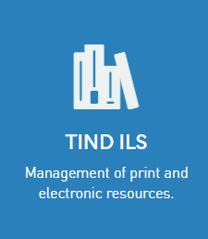
Robust Infrastructure
A Modern Interface
Powerful Search Options
Ongoing Development
Accessible API’s
TIND does not claim the data for other uses
Easy Data Loading

Slide 7
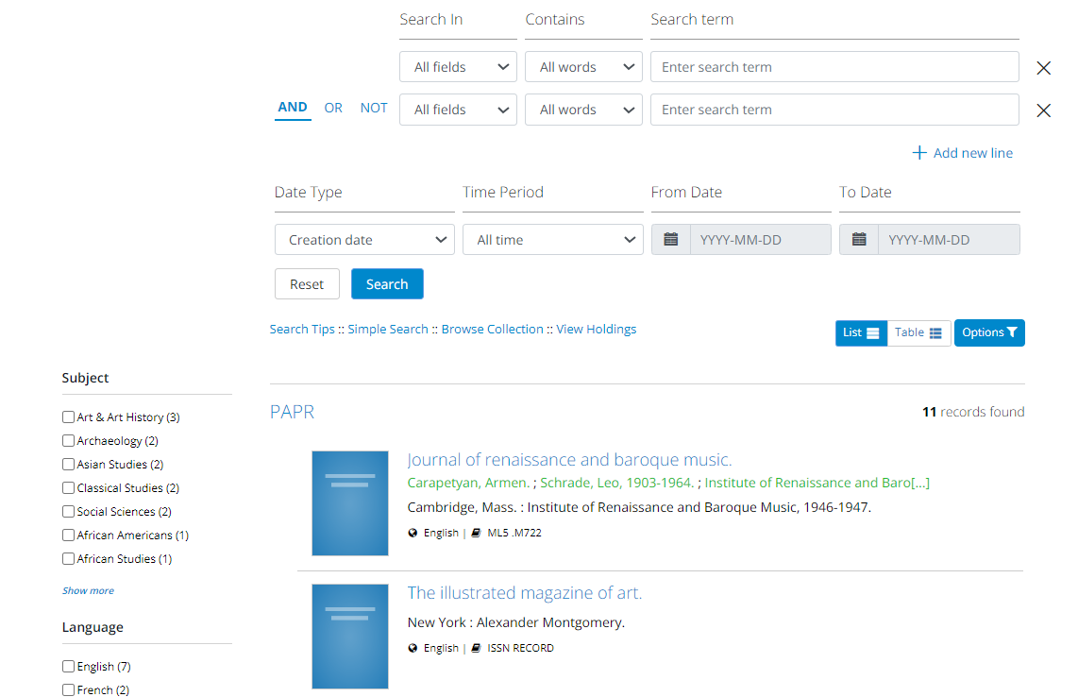
The Power of an ILS

Slide 8
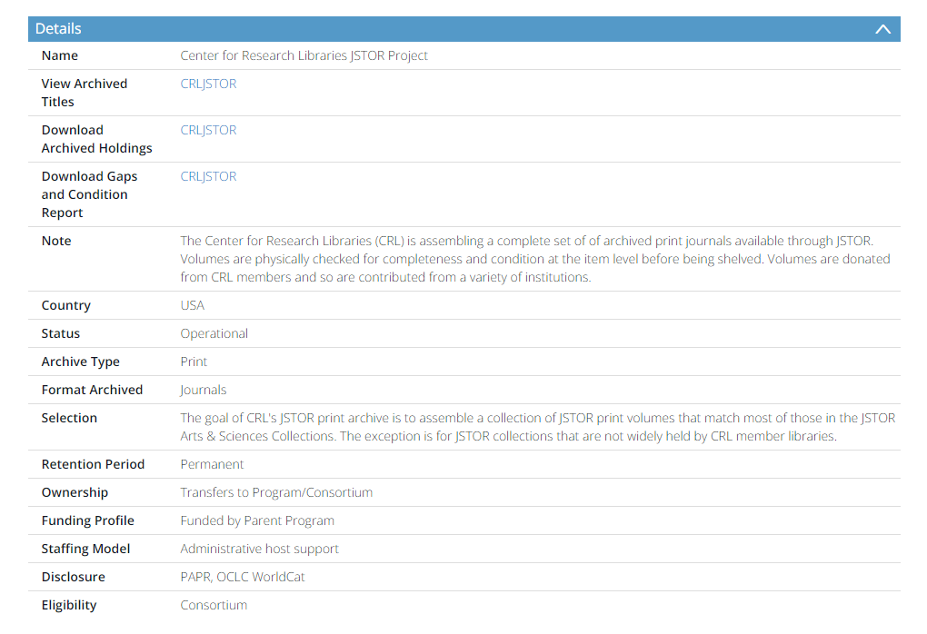
Directory

Slide 9
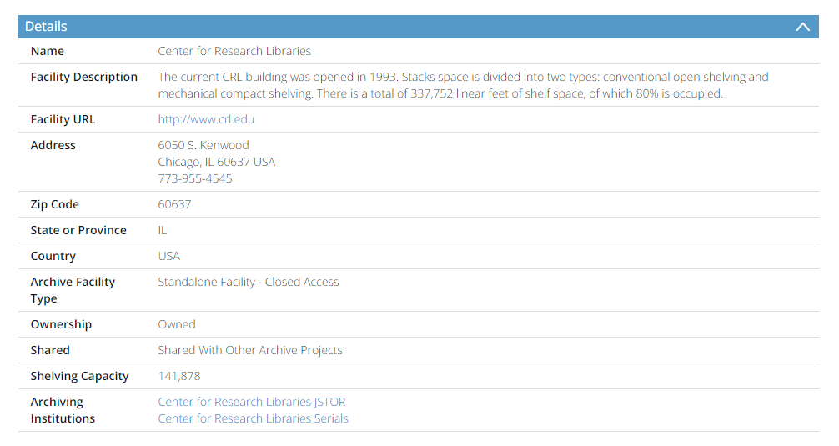
Facilities

Slide 10
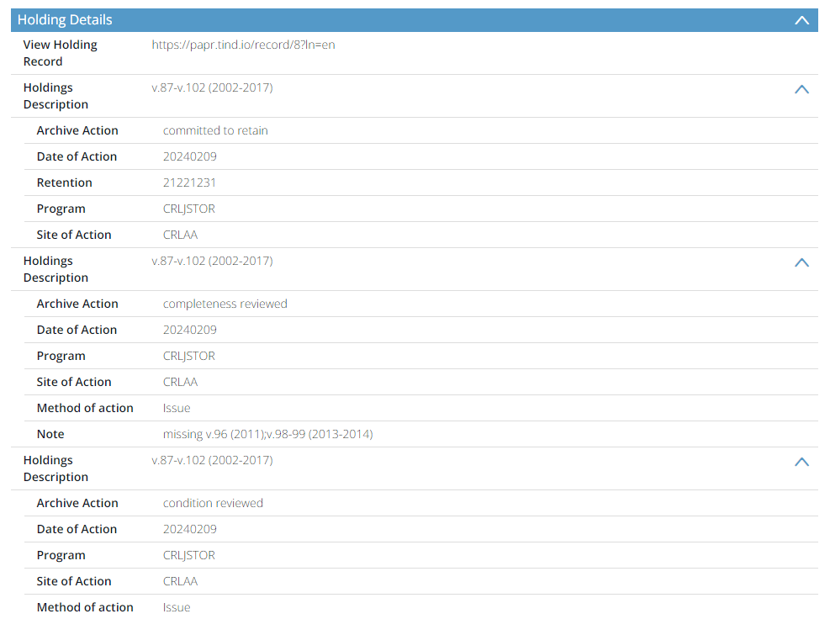
Holdings

Slide 11
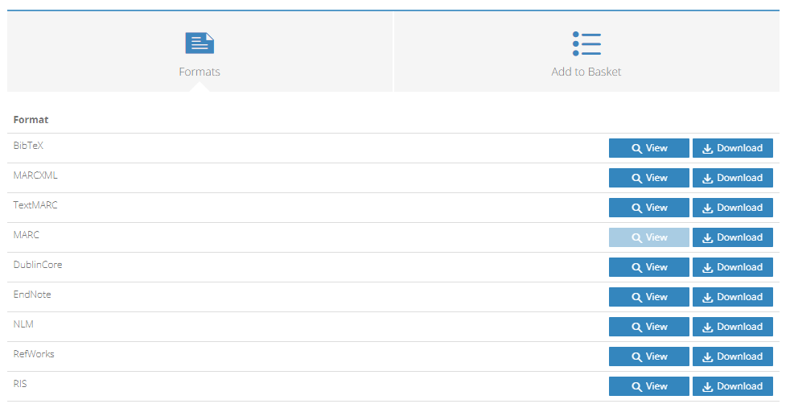
Data Exports

Slide 12
Timeline
Oct/Nov 2024
Jan/Feb 2025
TBD
Winter / Spring 2025
Community Meetings & Training
Begin
Migration
Development
for Statistics & User Tools
Go Live

Slide 13
Additional
Information
Sources
PAPR
http://papr.crl.edu/
TIND
https://www.tind.io/
Library Technology Guides – TIND ILS
https://librarytechnology.org/product/tind
Additional
Information Sources

Slide 14
Thank you!
Questions? Feedback?
Please contact: Amy Wood, wood@crl.edu

